Slide 1
I. Warm up:
Play game

Slide 2
II. New lesson

Slide 3
Saturday, January 19th, 2019
Unit 13: Would you like some milk?
Lesson 1
1. Look, listen and repeat

Slide 4
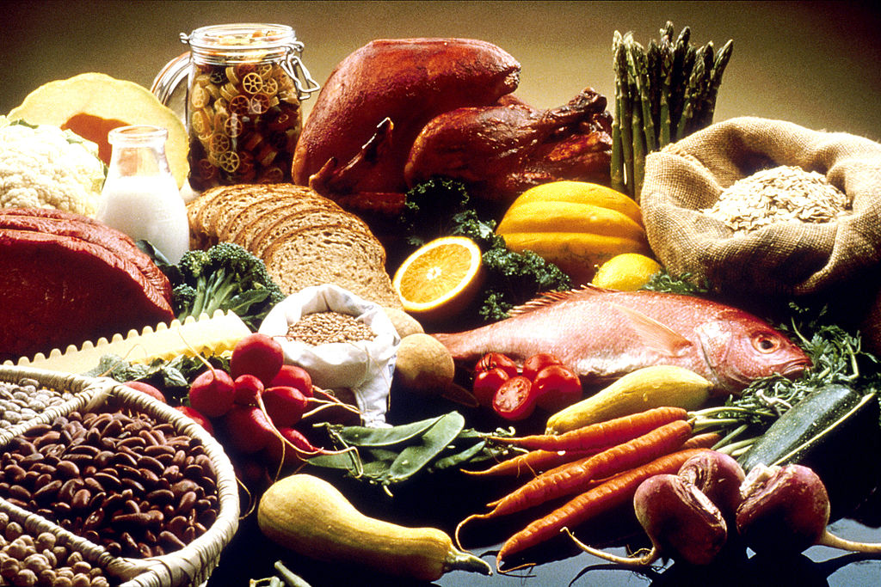
* New words:
food : thức ăn

Slide 5
* New words:
- fish: cá

Slide 6
* New words:
chicken: thịt gà

Slide 7
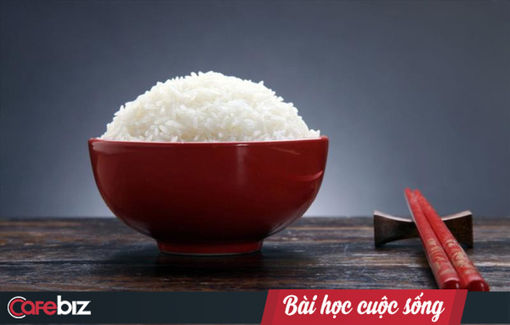
* New words:
- rice: cơm

Slide 8
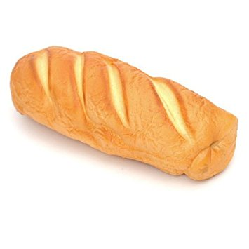
* New words:
- bread: bánh mì

Slide 9
New words:
beef: thịt bò

Slide 10
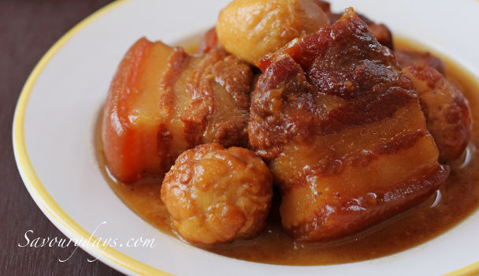
New words:
- pork: thịt lợn

Slide 11
* New words:
- drink : thức uống

Slide 12
* New words:
- orange juice : nước cam ép

Slide 13
* New words:
- milk : sữa

Slide 14
* New words:
- water: nước

Slide 15
New words:
- lemonade: nước chanh

Slide 16
New words:
- food
- fish
- chicken
- rice
- bread
- beef
- pork
- drink
- orange juice
- milk
- water
- lemonade

Slide 17
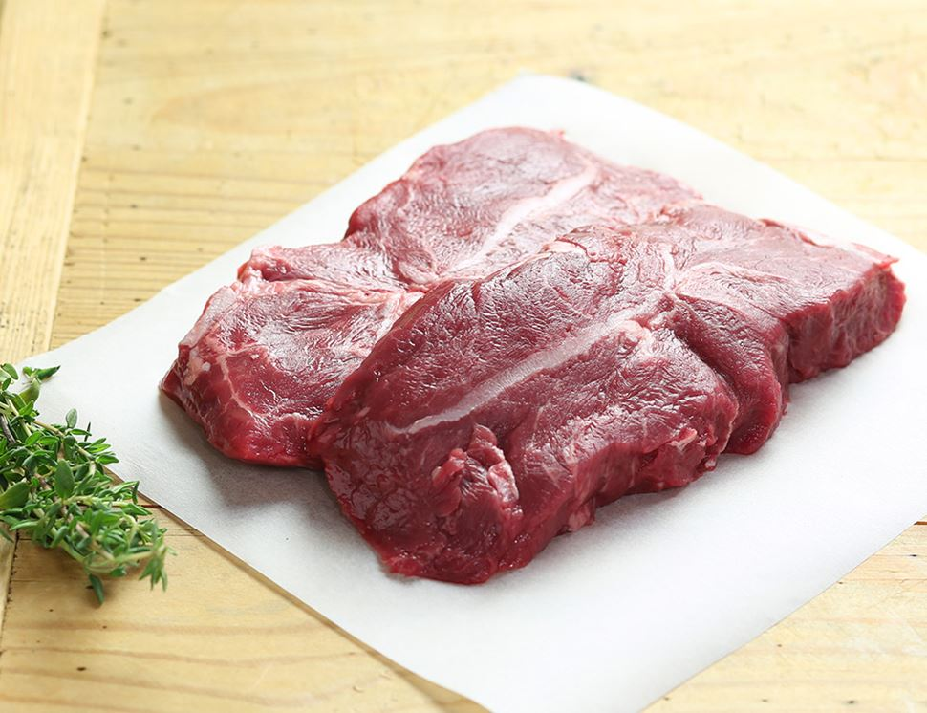
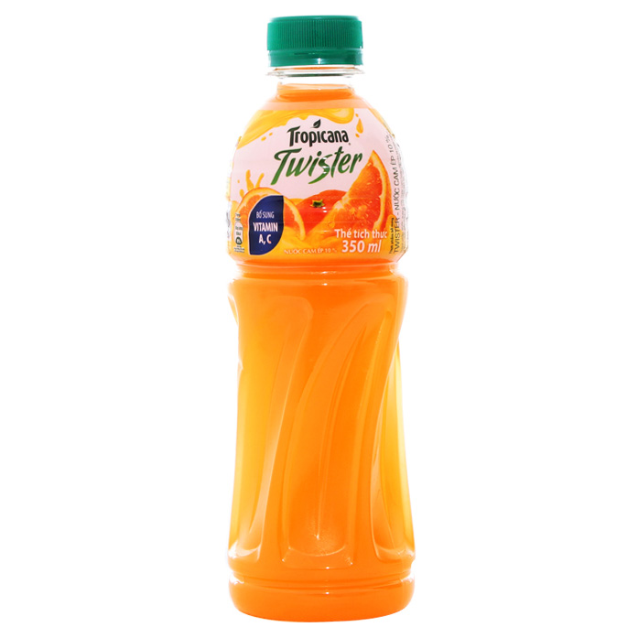
2. Point and say
+ Structure:
What’s your favourite food?
- It’s ……..
What’s your favourite drink?
- It’s ………………
beef
orange juice

Slide 18
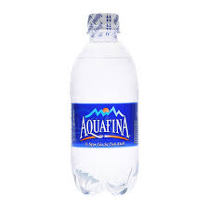
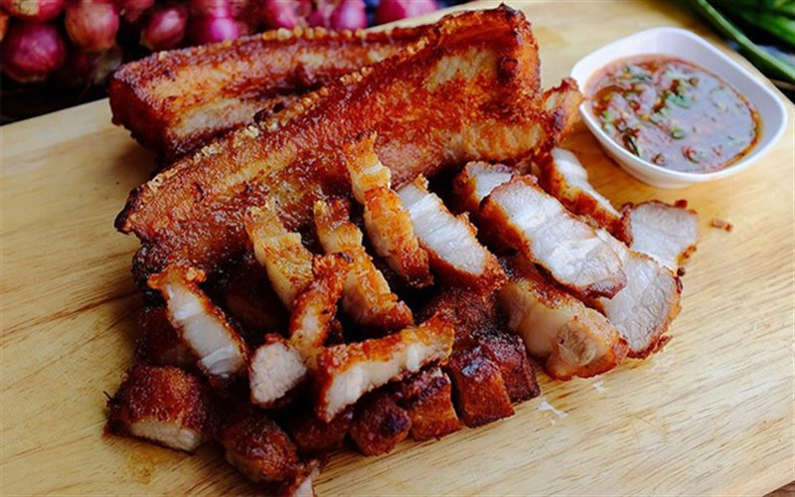
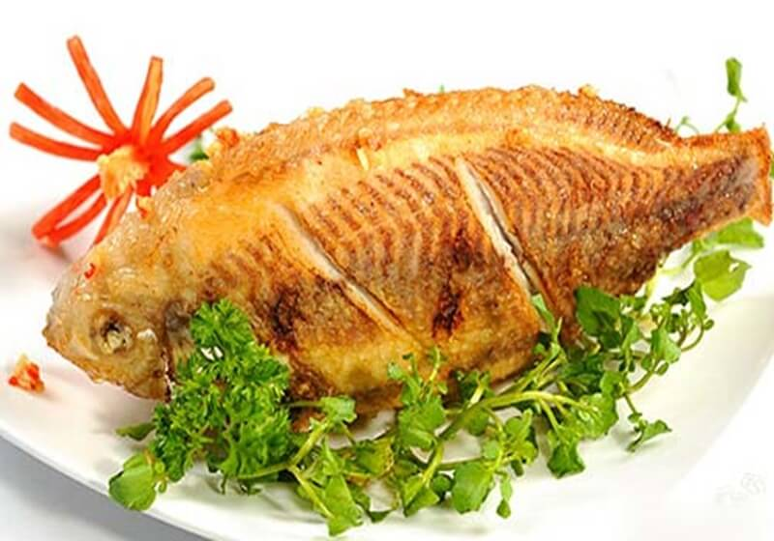
III. Consolidation

Slide 19
IV. Homework
- Learn new words and structure by heart

