Slide 1
Welcome to
F
F
our class

Slide 2
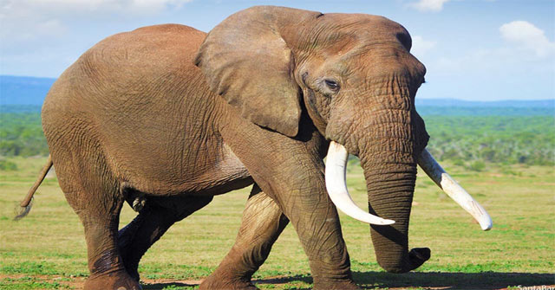
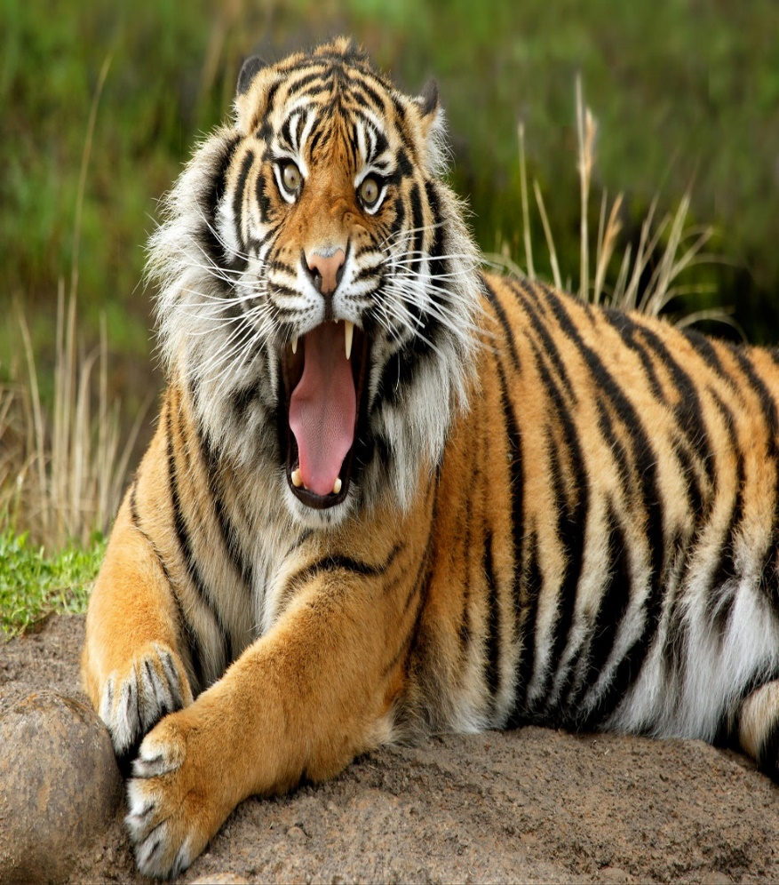
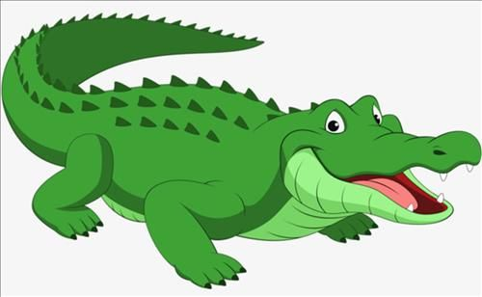
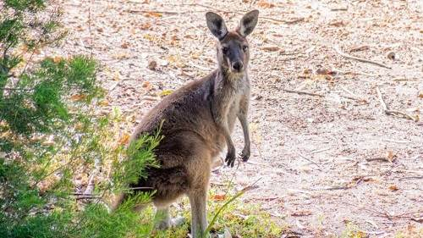
*New words
- kangaroo:
con chuột túi
- crocodile:
con cá sấu
- tiger:
con hổ
- elephant:
con voi
- animal:
động vật

Slide 3
*New words
- kangaroo:
con chuột túi
- crocodile:
con cá sấu
- tiger:
con hổ
- elephant:
con voi
- animal:
động vật

Slide 4
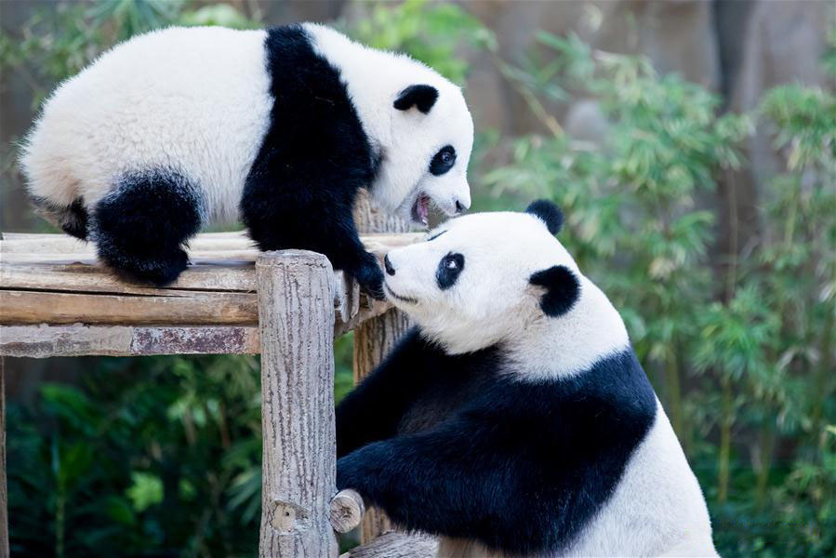
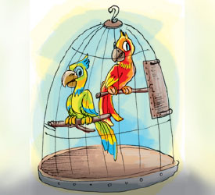
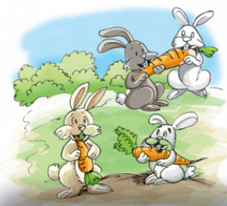
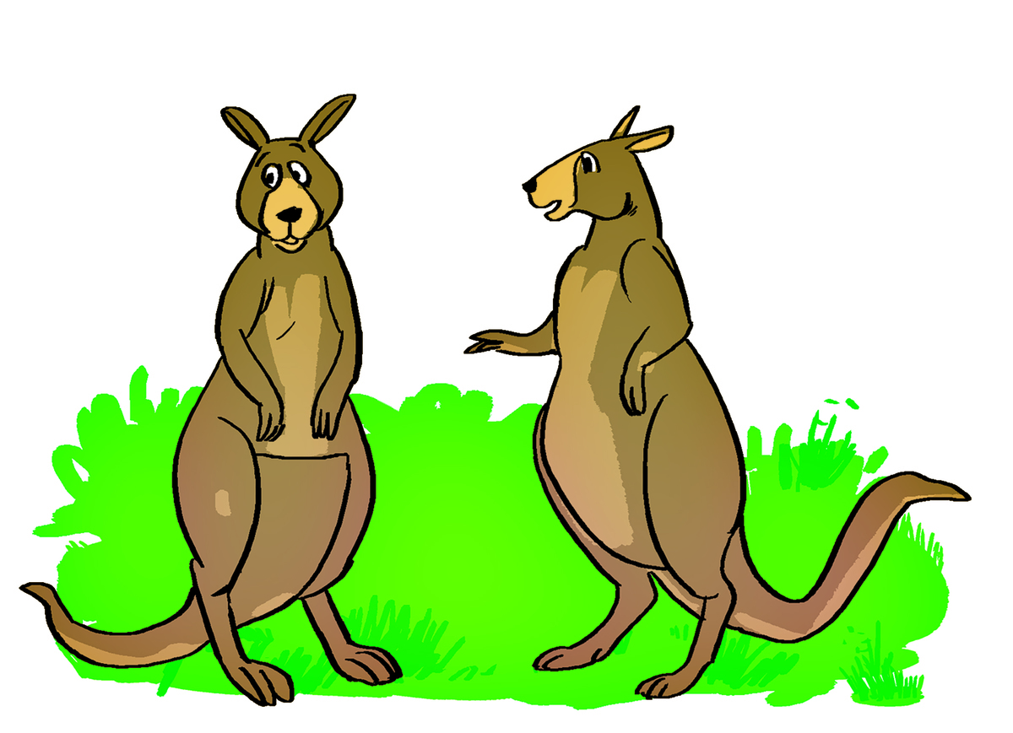
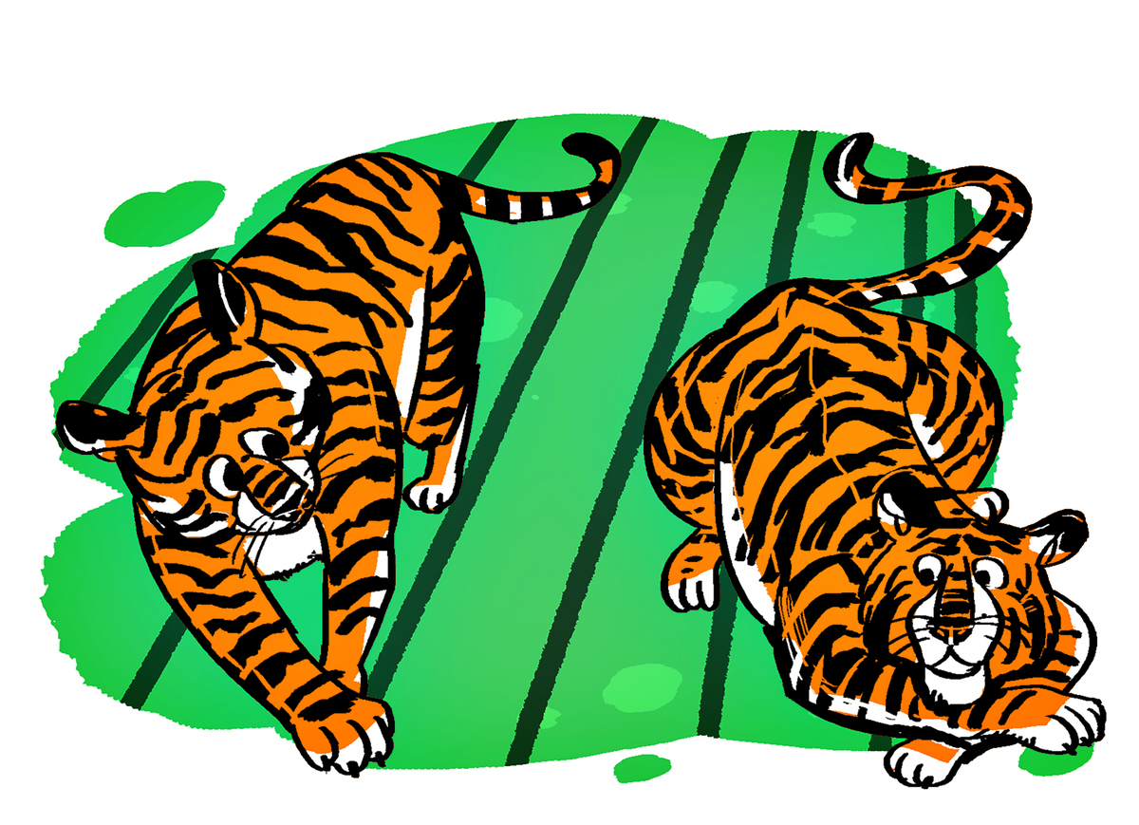
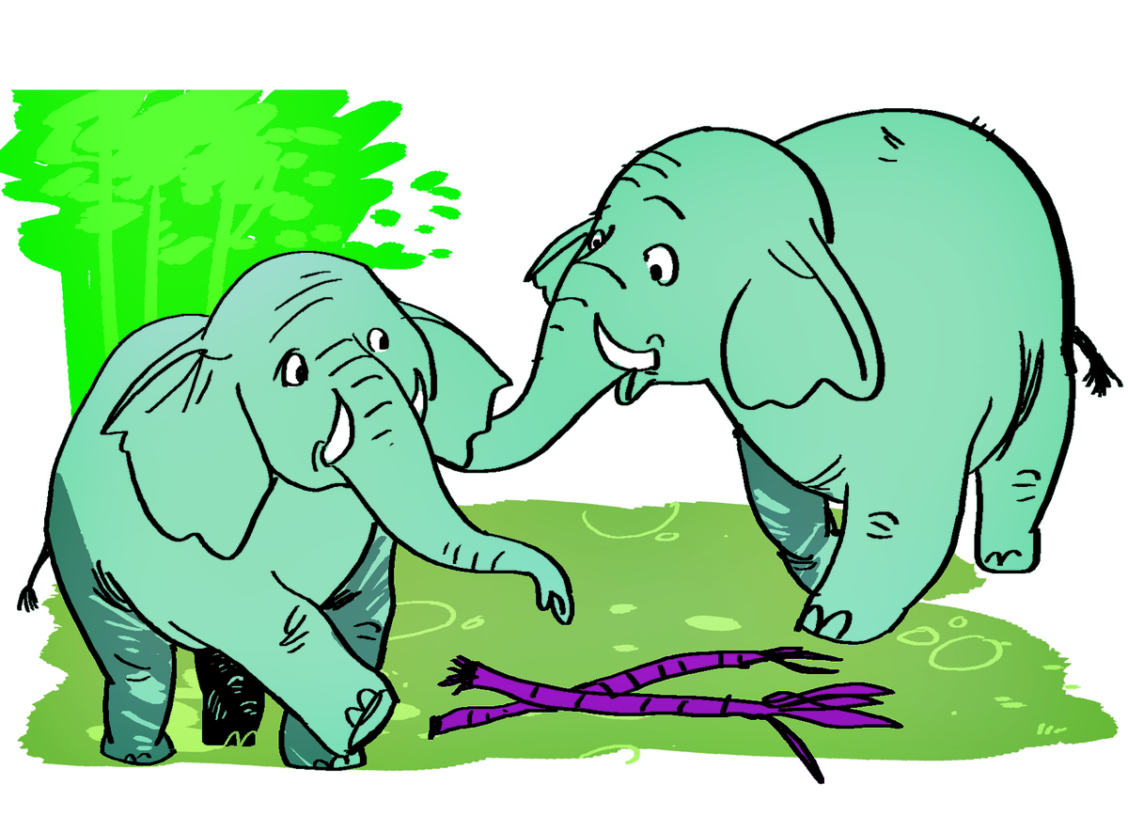
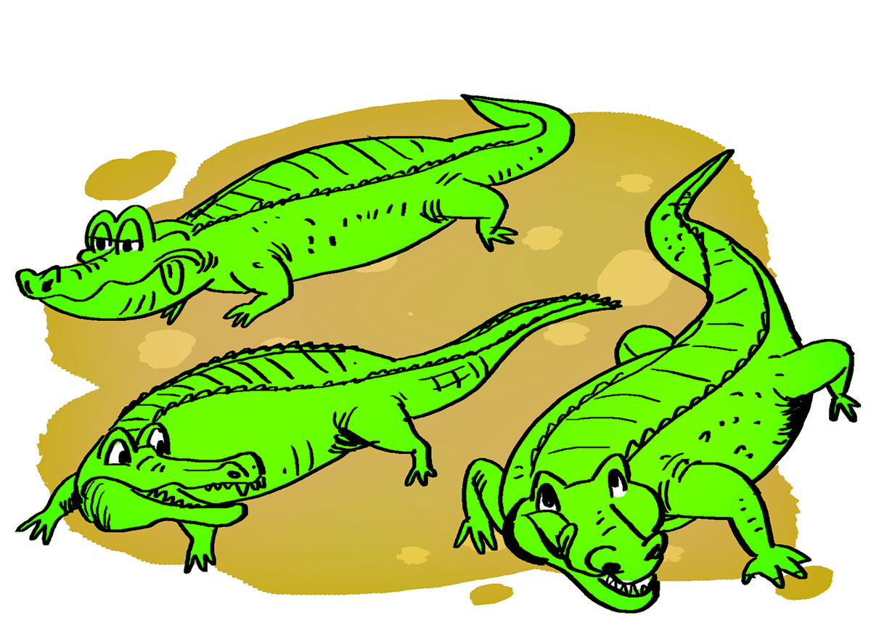
bears
Parrots
rabbits

Slide 5
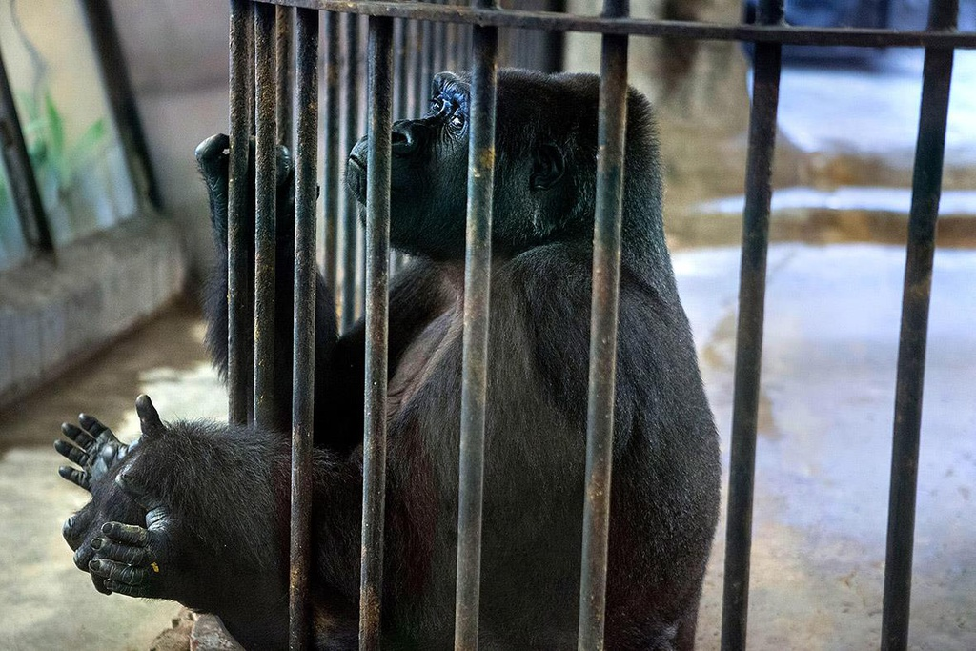
Dialogue
A: Let’s go to the zoo.
B: Great idea!
A: What animal do you want to see?
B: I want to see monkeys.

Slide 6
Consolidation

Slide 7
What animal do you want to see?
5
8
3
7
4
2
6
9
0
10
1
Time out
I want to see crocodiles.
I want to see tigers.
A
B
I want to see elephants.
I want to see monkeys.
C
D

Slide 8
5
8
3
7
4
2
6
9
10
1
animal/ What/ do/ want to/ you/see ?
Time out
What animal you do want to see?
What animal do you to want see?
A
B
What animal do you want to see?
What do animal you want to see?
C
D

Slide 9
5
8
3
7
4
2
6
9
10
1
I want to see kangaroos.
Time out
B
A
C
D

Slide 10
Homework
Learn by heart new words and structure
Prepare part: 3,4,5 on page 59

Slide 11
Thanks for your attention!

